Slide 1
ACE.AI SCORE PREDICTOR Mid-Term REVIEW
Carson Chen
May 15, 2019

Slide 2
Highlights
- I turned the full match history file into the format into a prediction dataset made up of prediction labels and variables.
- Current accuracy (cross-validated, looking back) is at 65%
- Tennis match results seem more random than expected, there are many factors that are difficult to be captured.

Slide 3

Review Progress
1. Exploratory data analysis and data cleansing
- Data overview, descriptive statistics, and cleaning
- Dataset transformation to make it a standard format for predictive modelling
2. Model building and validation
- Engineer feature set as predictor variables (ongoing)
- Build an initial benchmark model for reference
3. Product development
- Build data pipeline for the project
- Initialize database in RDS

Slide 4
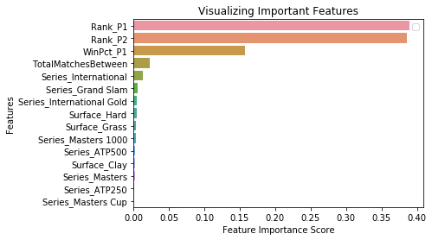
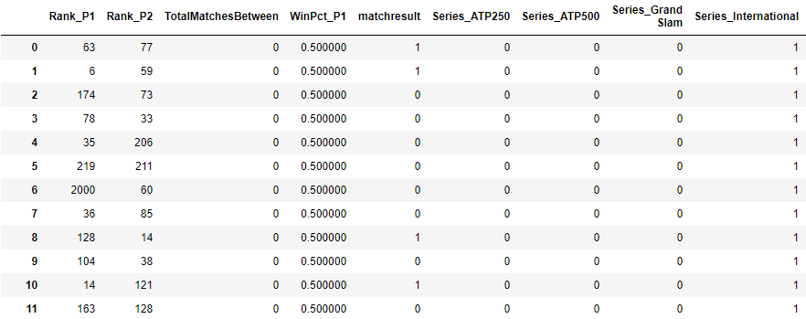
DEMO/ANALYSIS
Prediction data set
Variable Importance

Slide 5
LESSONS LEARNED
Specifics of the data:
- Player rank is the single most important factor to determine a match outcome, which is indicating the current ranking mechanism is quite accurate
General deployment strategies
- It’s more effective to present result in the angle of “my player” versus “the opponent player”, rather than of a detached stance ‘A vs B’
- Offline prediction is preferred for a better user experience, but it requires setting up a larger database

Slide 6

RECOMMENDATIONS/Next Steps
2. Model building and validation
- Iteratively develop a set of models with engineered features, optimize parameters to find the best model
- Validate the model using primary and potential alternative metrics such as F1-score
3. Product development
- Build Flask app for deployment
- Build user interface prototype for the project

